Slide 1
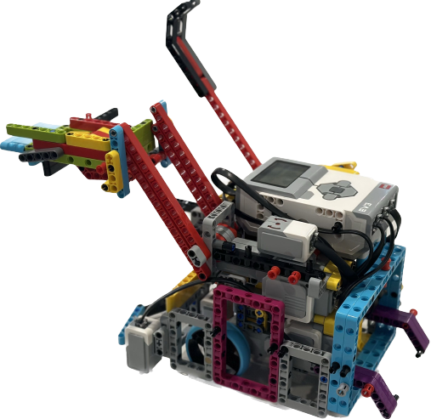
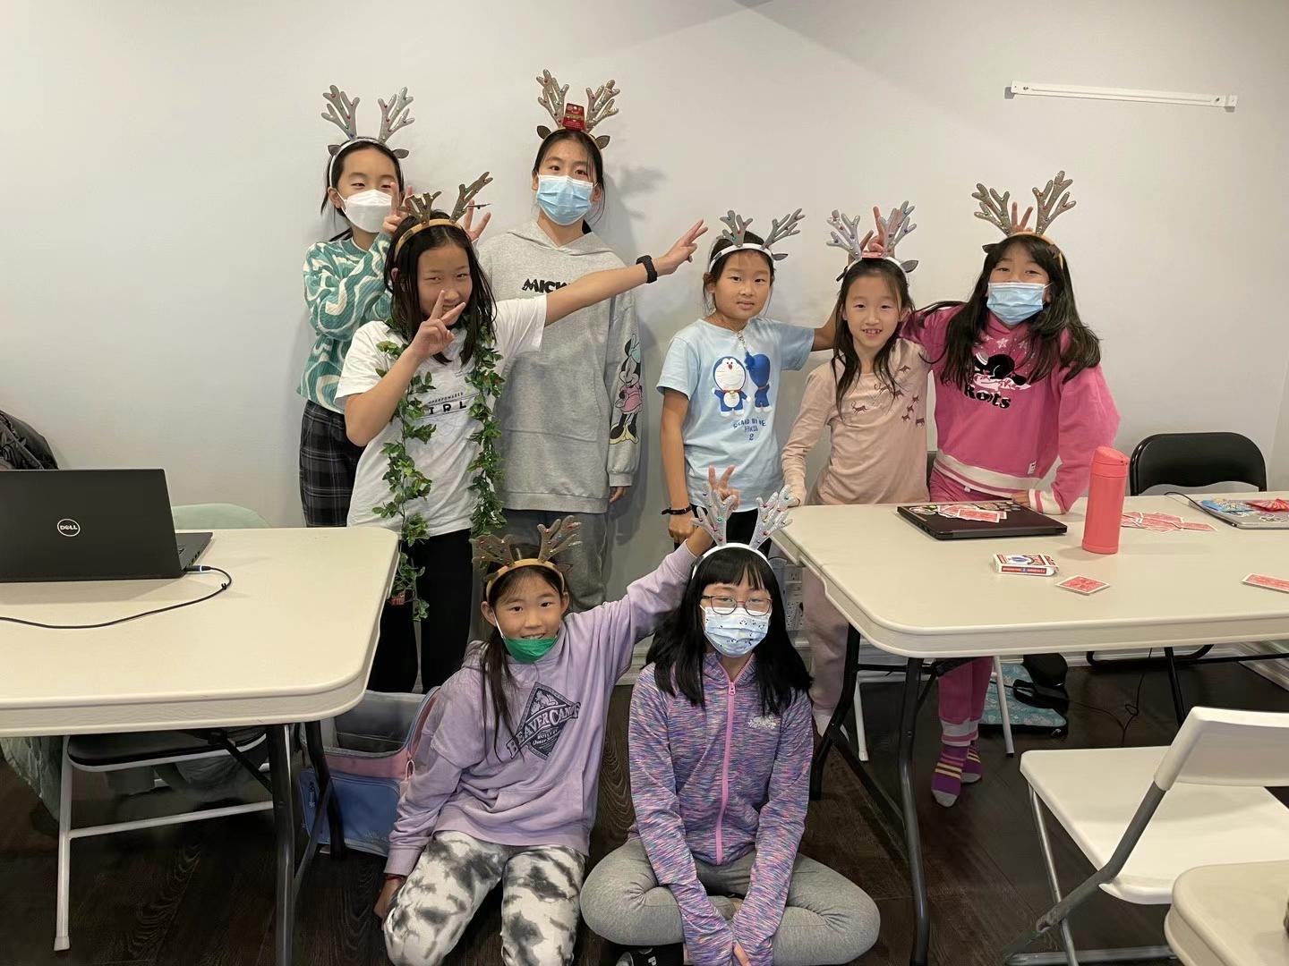

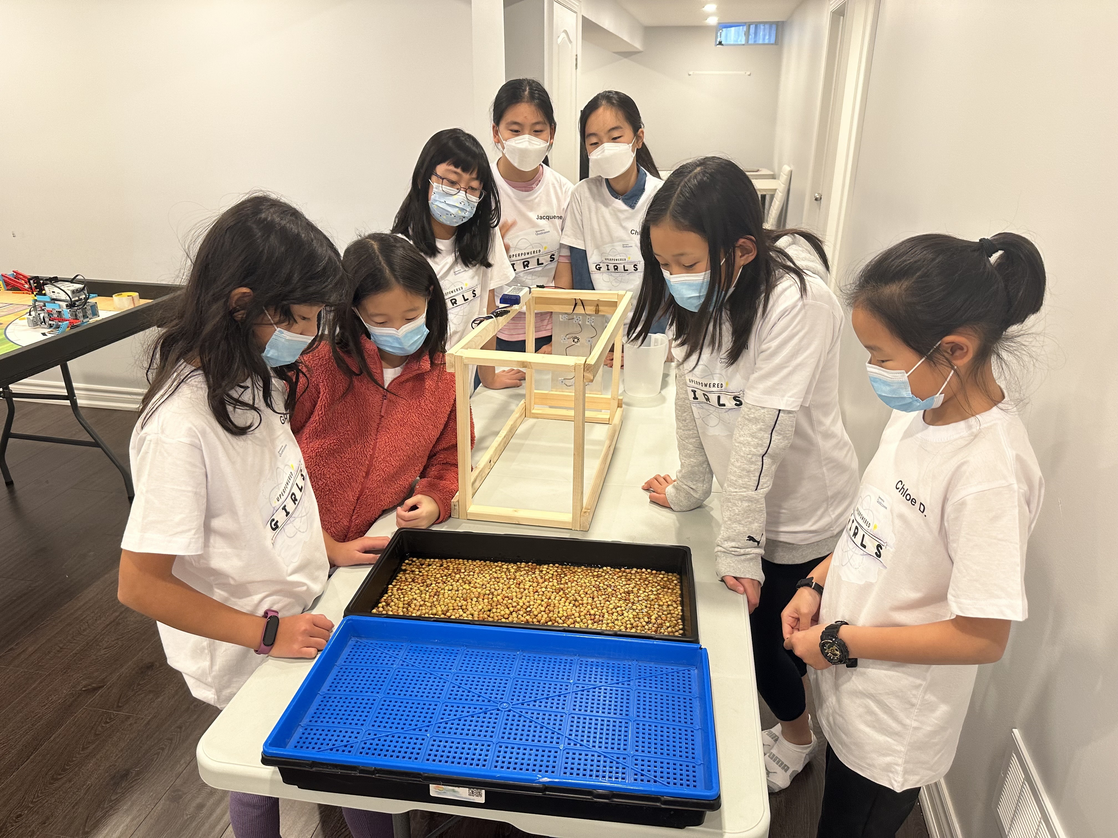
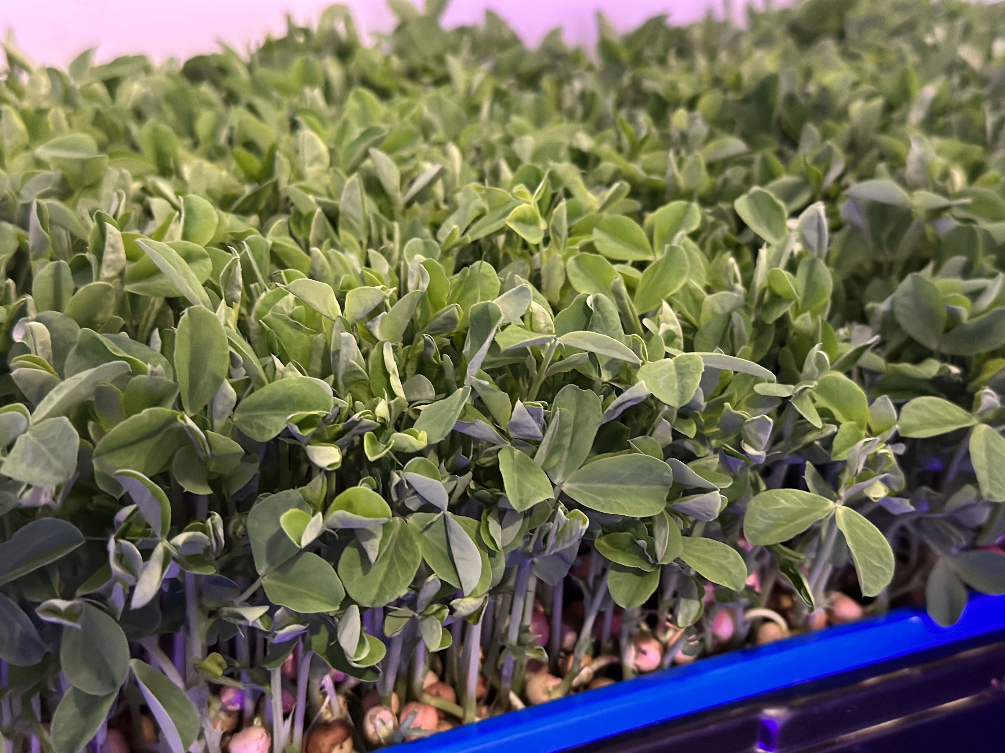
#55482 Superpowered Girls
Solvers Mind Edu., Aurora
Fun Facts:
Rookie team
We love Pea Shoots
All girls

